Slide 1

Restaurant Recommendation System Using Yelp Data
Sarthak Bora
Capstone Project Presentation
April 2025
Notes:
_"Good afternoon, everyone. My name is Sarthak Bora, and I’m excited to present my capstone project titled ‘Restaurant Recommendation System Using Yelp Data.’
This project is a culmination of everything I’ve learned in this program — combining real-world datasets, machine learning models, sentiment analysis, and deployment into an actual working product.
Over the next 25–30 minutes, I’ll walk you through the motivation, methods, results, and impact of the system I built — and I’ll also demonstrate how it works using an interactive app."_

Slide 2
Agenda
Introduction
Prior Work
Methodology
Experiments and Results
Web Application Demonstration
Conclusions and Future Work
Notes:
Here’s a quick overview of today's presentation. We’ll begin with an introduction to the problem we are tackling. Then we will look at prior work and understand what research has already been done. The bulk of this presentation will dive into the methodology — how I designed and implemented the system. Following that, I'll share key experiments and results, and demonstrate the working web application. Finally, I will conclude with the major takeaways and exciting possibilities for future work.

Slide 3
Problem Description
Traditional recommenders mainly depend on numeric star ratings.
Ratings do not capture customer emotions or detailed experiences.
Example: A restaurant with 4.5 stars might still have poor recent service.
Need a system that blends ratings with real customer emotions.
Notes:
"Let’s start by discussing the problem. Restaurant recommendation systems today mainly rely on star ratings. But these ratings don't tell the full story. For example, a restaurant might have a 4.5-star rating because of reviews two years ago. In reality, recent reviews could be full of complaints about bad service or food quality.
Moreover, numerical ratings don't capture the emotional experiences — things like ambiance, warmth of service, or even how the food made the customer feel. This creates a disconnect between what users expect and what they experience. So, the real challenge is to move beyond just numbers and capture the emotions hidden in the text reviews, to build more trustworthy, real-time recommendations."

Slide 4
Objective
Build a hybrid system combining Collaborative Filtering and Sentiment Analysis.
Recommend restaurants considering both behavioral patterns and emotions.
Improve trustworthiness, personalization, and user discovery experience.
Deploy results through an easy-to-use interactive web app.
Notes:
Given that problem, my objective was clear. I wanted to build a hybrid recommendation system that does two things: First, it should understand user behavior patterns — like which restaurants a user likes based on past ratings, using Collaborative Filtering. Second, it should read between the lines — extracting the emotional tone from user reviews using Sentiment Analysis. By combining these two dimensions, the system can recommend restaurants that are not only statistically popular but also emotionally satisfying. To make the system truly useful, I developed an interactive web application so that users can easily filter recommendations based on their preferences and needs."

Slide 5
Importance of Emotional Sentiment
Star ratings oversimplify rich customer feedback.
Textual reviews capture service quality, ambiance, staff behavior.
Sentiment analysis reveals subtle positive/negative aspects missed by ratings.
Emotional-aware recommendations build higher user trust.
Notes:
Why is emotional sentiment important in recommendations? Let’s consider this: two restaurants might both have a 4.0-star rating, but the emotional tone behind the reviews can be very different. One restaurant might have reviews like 'great food but terrible service' while another might have 'good food and amazing atmosphere.' If we only look at stars, we miss this nuance. Sentiment analysis helps us capture this hidden information — things like customer happiness, disappointment, or satisfaction — directly from the text. Thus, it allows the recommendation system to prioritize experiences that users would genuinely appreciate, not just restaurants with high ratings."

Slide 6
Prior Work – Collaborative Filtering
Ha (2022) explored user-based/item-based CF to improve Yelp recommendations.
Matrix Factorization like SVD better captures hidden user preferences.
Challenges: cold-start (new users/items) and data sparsity issues.
Notes:
"Let’s now discuss some important prior work. Collaborative Filtering is one of the most widely used techniques in recommendation systems. It relies on the principle that if two users liked similar items in the past, they are likely to agree in the future too. Research by C.H. Ha and others has shown that collaborative filtering — especially matrix factorization techniques like Singular Value Decomposition (SVD) — can predict user preferences very effectively, even in sparse datasets.
However, traditional CF has major challenges:
The cold start problem: when a new user or new restaurant enters the system, there is no past history to work with.
Data sparsity: most users only rate a few items, leaving large gaps in the interaction matrix. So while CF is powerful, it cannot solve everything alone, especially emotional aspects."_

Slide 7
Prior Work – Hybrid Models and Sentiment
Sawant and Pai (2022) built hybrid systems using metadata + ratings.
Sentiment from reviews improves personalization further.
Xu and Lee (2021) showed integrating attributes like service/ambiance improves user experience.
Notes:
Other researchers have explored ways to overcome the limitations of traditional CF. S. Sawant and G. Pai built hybrid models that combine collaborative filtering with content-based filtering — looking not just at user ratings but also metadata like restaurant cuisines, locations, and price ranges. Further, J.L. Xu and Y. Xu explored integrating sentiment analysis into recommendation systems, showing that when emotional aspects like service and ambiance were included, user satisfaction improved. These studies provided strong motivation to design my project as a hybrid system, blending rating patterns with emotional understanding."

Slide 8
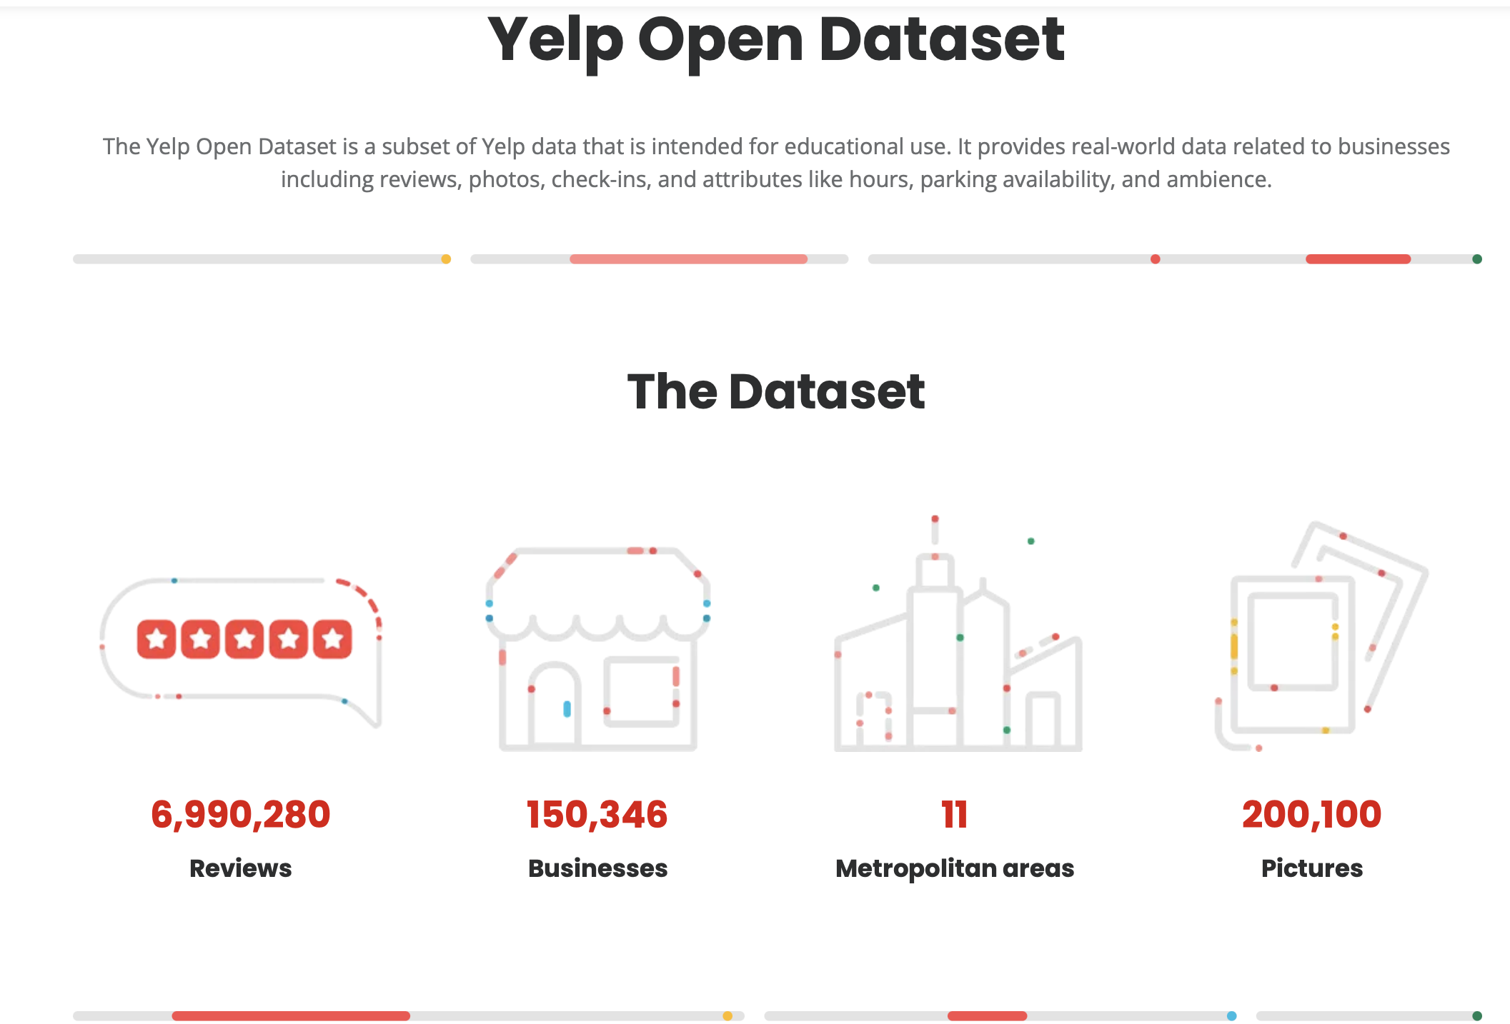
Dataset Overview
Yelp Academic Dataset used: Reviews + Business metadata.
Focus on five cities: Philadelphia, Indianapolis, Tampa, Tucson, Nashville.
Final dataset: ~2.5 million reviews filtered down to restaurant-focused subset.
Rich metadata: cuisines, stars, location, open/closed status.
Notes:
For this project, I used the Yelp Academic Dataset, which is a popular benchmark dataset for recommendation system research. It includes millions of reviews from users across various types of businesses, such as restaurants, gyms, salons, and more. However, for this project, I focused purely on the 'Restaurants' category. I selected five diverse cities — Philadelphia, Indianapolis, Tampa, Tucson, and Nashville — each offering a wide variety of cuisines and restaurant types. This allowed me to test the recommendation system across different demographics and cultural food preferences. The initial raw dataset was massive — over 6 million reviews — but after applying category and city filters, I curated a high-quality subset of around 2.5 million restaurant-specific reviews. Each review included attributes like business name, address, star rating, review text, date of posting, and whether the business is currently open or closed. This rich combination of numerical, textual, and categorical data made it ideal for building a hybrid system."

Slide 9
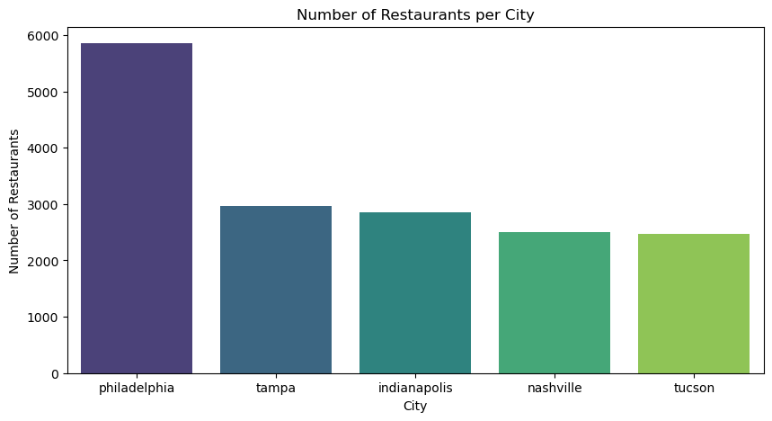
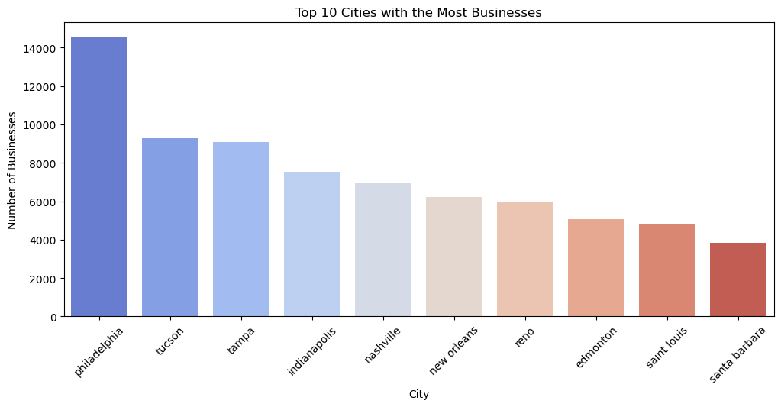
Data Preprocessing
Filter non-restaurant businesses and short/incomplete reviews.
Add review length, review year, city metadata.
Merge datasets on Business ID for unified analysis
Notes:
"After selecting the dataset, preprocessing was crucial to make the data model-ready. First, I filtered out non-restaurant businesses like car repair shops or yoga studios — since they are irrelevant for restaurant recommendations. Next, I removed very short reviews — anything under 20 characters — because one-word reviews like 'Good' or 'Bad' provide no useful sentiment information for analysis. I also engineered new features such as:
Review Length: Longer reviews often carry more emotional context than short ones.
Year of Review: Useful to analyze trends over time, like improving or declining restaurant quality.
City Name Extraction: Important for location-based filtering inside the app later. I merged the cleaned business and review datasets on the Business ID key.
This step ensured that every review in my system had complete business information linked with it — such as name, city, categories, star ratings, and hours of operation.
A quick exploratory data analysis showed that review lengths varied greatly, but typically most useful reviews had between 200 to 800 characters."_

Slide 10
Sentiment Analysis Techniques
VADER: Rule-based quick scoring.
TF-IDF + Logistic Regression: Classical ML on text features.
BERT: Deep contextual embeddings and fine-tuning for emotional detection.
Notes:
"Once the data was prepared, the next major task was to extract emotional sentiment from the review texts. I tried three major techniques:
VADER: A rule-based model pre-tuned for social media and review texts. It uses a dictionary of words with assigned sentiment scores and quickly analyzes sentences. However, VADER struggles with complex phrases like sarcasm or context switches.
TF-IDF + Logistic Regression: Here, I first transformed the text into numerical feature vectors using Term Frequency-Inverse Document Frequency (TF-IDF). Then I trained a simple Logistic Regression model to classify reviews as positive or negative. This method is more robust than VADER, and achieves better baseline performance, but it still struggles when reviews are long and nuanced.
BERT: BERT, or Bidirectional Encoder Representations from Transformers deep learning model. I fine-tuned a pre-trained BERT model specifically on Yelp restaurant reviews to predict sentiment.
BERT understands context deeply, such as 'The food was great, but the service was awful,' recognizing mixed sentiments within the same review.
In short, each method represented a step up in sophistication, with BERT delivering the most accurate and emotionally aware sentiment understanding."_

Slide 11

Sentiment Model – VADER
Lightweight, no training needed.
Good for fast estimations.
Struggles with sarcasm, context-heavy reviews.
Notes:
Starting with the first sentiment analysis approach: VADER. VADER stands for Valence Aware Dictionary for sEntiment Reasoning. It is a lexicon and rule-based sentiment analysis tool that is particularly good at analyzing social media texts, like tweets or short reviews. The major advantage of VADER is its speed — it doesn't require any training phase. It assigns pre-set positive or negative scores to words and phrases and sums them up. While VADER is good for quick estimations and works well on straightforward reviews like 'Loved the food!' — it struggles when faced with complex sentences, sarcasm, or mixed sentiments. For instance, if a review says, 'The waiter forgot our order but eventually made up for it,' VADER might not capture the nuanced recovery sentiment. Therefore, while it served as a good starting baseline, I needed more sophisticated models for deeper emotional understanding."

Slide 12
Sentiment Model – TF-IDF + Logistic Regression
Transform text to vector space using TF-IDF.
Logistic Regression classifier predicts polarity.
Good accuracy (~81.7%), interpretable results.
Notes:
"The second approach I implemented was a more traditional machine learning technique: First, I extracted features from the text using TF-IDF — Term Frequency-Inverse Document Frequency — which transforms each review into a weighted numerical vector. The idea behind TF-IDF is simple but powerful: words that appear frequently in a document but rarely across other documents are more important. For example, words like 'delicious' or 'slow service' could carry strong sentiment in a restaurant context. Once I had the feature vectors, I trained a Logistic Regression model to classify reviews into positive or negative sentiment. This method achieved about 81.7% accuracy, much better than VADER. However, it still had some limitations:
It treats words independently and ignores word order and context.
It doesn’t understand relationships between words like 'not good' versus 'good.' Despite that, this model provided a strong intermediate performance benchmark."_

Slide 13
Sentiment Model – BERT
Deep Bidirectional Encoder Representations from Transformers.
Fine-tuned on Yelp reviews for custom sentiment classification.
Achieved highest accuracy (91.5%), robust to context variations.
Notes:
"Finally, the most powerful technique I used was BERT — Bidirectional Encoder Representations from Transformers. Unlike traditional models, BERT reads a sentence in both directions — left to right and right to left — at the same time. This allows it to capture the deep context of every word. For instance, it understands the difference between 'I am happy with the service' and 'I am not happy with the service.' I fine-tuned a pre-trained BERT model specifically on a labeled dataset of restaurant reviews. Training BERT was computationally expensive and required GPU acceleration, but it delivered the best results. BERT achieved a sentiment classification accuracy of 91.5% — significantly outperforming both VADER and TF-IDF methods. Therefore, I chose BERT outputs as the final sentiment scores for the hybrid recommendation model."

Slide 14
Collaborative Filtering Overview
Collaborative Filtering via SVD captures user-restaurant interactions.
Factorizes rating matrix into latent spaces.
Handles missing data better than neighborhood methods.
Notes:
Now moving to the second half of the hybrid model: Collaborative Filtering. Collaborative Filtering is based on the principle that if user A and user B have similar tastes, then the restaurants liked by user A will likely be liked by user B as well. In this project, I implemented Matrix Factorization using Singular Value Decomposition (SVD). SVD factorizes the very large user-business rating matrix into two smaller matrices:
One representing user features
One representing restaurant features By multiplying these matrices back, we can predict unknown ratings for unseen user-restaurant pairs. This technique is especially powerful because it captures hidden patterns that are not obvious directly — for example, a user who likes Mexican food might also like Tex-Mex, even if they never rated Tex-Mex restaurants before.

Slide 15
SVD Model Performance
Model | RMSE
SVD (optimized) | 0.982
Notes:
"Here are the evaluation results for the Collaborative Filtering model using SVD. The key metric here is RMSE — Root Mean Square Error — which measures the average prediction error between the predicted rating and the actual user rating. Lower RMSE indicates better prediction quality. In my model, the SVD approach achieved an RMSE of 0.982. An RMSE under 1 is considered quite strong for recommendation systems, especially given the size and sparsity of Yelp data. This gives us a strong baseline for predicting user preferences based purely on rating behaviors. But again, ratings alone aren't enough — which is why combining it with emotional sentiment makes the final recommendation much stronger."

Slide 16
Hybrid Recommendation Model
Final hybrid score combines CF prediction and Sentiment strength.
Formula:
Hybrid Score = 0.6 × CF Score + 0.4 × Sentiment Score
More stable and emotionally aligned recommendations.
Notes:
"Building the hybrid recommendation model was the most important innovation of this project. The final hybrid score for a restaurant was computed by blending the Collaborative Filtering score and the Sentiment Analysis score. The formula is simple but effective:
Hybrid Score = 0.6 × CF Score + 0.4 × Sentiment Score Why 60/40? Through experimentation, I found that giving slightly more weight to CF helps maintain user preference consistency, while adding 40% from emotional sentiment captures quality experiences. This way, even if a restaurant is statistically popular, it won't be recommended if recent sentiments are negative — and hidden gems with emotionally rich positive reviews rise up in rankings. Thus, the system achieves a balance between behavior-driven and emotion-driven recommendations."_

Slide 17
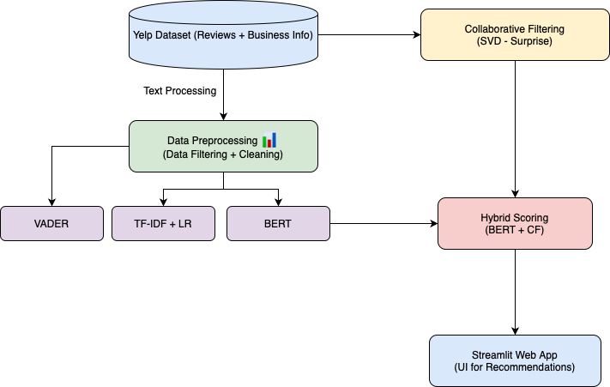
Hybrid Recommendation Architecture
Notes:
This architecture diagram summarizes the full workflow of the system. We start with raw Yelp review and business data, followed by data cleaning and preprocessing. From there, two parallel pipelines are built:
One pipeline runs collaborative filtering using SVD on ratings.
Another pipeline performs sentiment analysis on review texts using BERT. The outputs from both pipelines are merged to compute the final hybrid score. Finally, the top-ranked restaurants are recommended to the user, personalized by their city and cuisine preferences. This two-pronged architecture ensures that both statistical preferences and emotional satisfaction are considered simultaneously."_

Slide 18
Top-10 Restaurants (Tucson)
Rank | Restaurant Name | Categories | Business Stars | Review Count | Avg BERT Score | CF Score | Hybrid Score
1 | Tumerico | Mexican, Gluten-Free, Vegetarian | 5.0 | 724 | 4.83 | 4.82 | 0.975
2 | The Blacktop Grill | Hot Dogs, Food Stands, Nightlife | 5.0 | 100 | 4.50 | 4.72 | 0.929
3 | Tacos Apson | Mexican | 4.5 | 248 | 5.00 | 4.43 | 0.909
4 | The Quesadillas | Tacos, Mexican | 4.5 | 517 | 4.22 | 4.68 | 0.900
5 | The Little One | Mexican, Breakfast & Brunch | 4.5 | 365 | 4.50 | 4.57 | 0.900
6 | Aqui Con El Nene | Fast Food, Mexican, Food Stands | 4.5 | 335 | 4.60 | 4.50 | 0.894
7 | Taqueria Juanito's | Mexican | 4.5 | 390 | 4.80 | 4.41 | 0.891
8 | Sunny Daze Cafe | Diners, Tex-Mex, Cafes | 4.5 | 421 | 5.00 | 4.29 | 0.883
9 | Anita Street Market | Food, Grocery, Mexican | 4.5 | 189 | 5.00 | 4.29 | 0.883
10 | Salsa Verde Restaurant | Mexican | 4.5 | 342 | 4.29 | 4.49 | 0.869
Notes:
"This table shows the Top-10 restaurant recommendations for Tucson, Arizona, using the final hybrid model. Notice that it's not just the restaurants with the highest star ratings. Instead, the model surfaces restaurants like 'Tumerico' and 'The Blacktop Grill' — which have extremely high hybrid scores based on both user behavior and positive emotional sentiments in reviews. Interestingly, many of these restaurants are not large chains but local favorites — highlighting how the hybrid system promotes hidden gems over just big-name popularity. This balance between rating patterns and emotional quality makes the recommendations more meaningful for users seeking authentic dining experiences."

Slide 19
Observations
Hybrid model highlights hidden gems with strong sentiment.
Balances popularity + emotional satisfaction.
Surface trustworthy recommendations beyond just ratings.
Notes:
"From the experiments and results, several interesting observations emerged:
First, hybrid scoring consistently promoted restaurants that users emotionally raved about, not just those with high ratings.
Second, small, local restaurants benefited more from this approach — because their authentic experiences were captured better by positive sentiments.
Third, the system was more resilient to review manipulation — even if a restaurant had artificially boosted ratings, negative sentiment patterns could still push it lower in the ranking. Overall, these observations reinforce the power of combining structured data (ratings) with unstructured data (reviews) for better, fairer recommendations."_

Slide 20
Streamlit App Overview
Sidebar filters: City, Cuisine, Minimum Stars, Open Now.
Dynamic Top-N restaurant recommendations.
Easy-to-use offline web deployment.
Notes:
To make the recommendation system usable and interactive, I built a simple web application using Streamlit. Streamlit is a Python-based framework designed for quickly turning machine learning models into web apps without heavy front-end coding. In the app, users can:
Select a city among the five we focused on.
Choose one or more cuisines of interest.
Filter by minimum Yelp star rating.
Optionally only see restaurants that are open now.
And select how many top recommendations they want to see. The app dynamically fetches the top restaurants based on these filters and the final hybrid score. This approach ensures that even non-technical users can easily explore emotionally intelligent recommendations through a simple interface."_

Slide 21
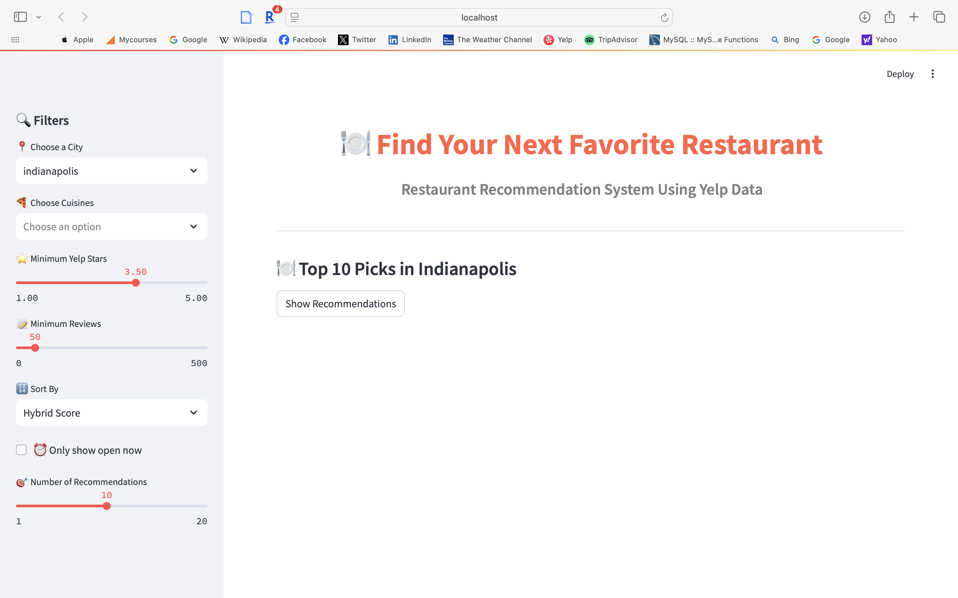
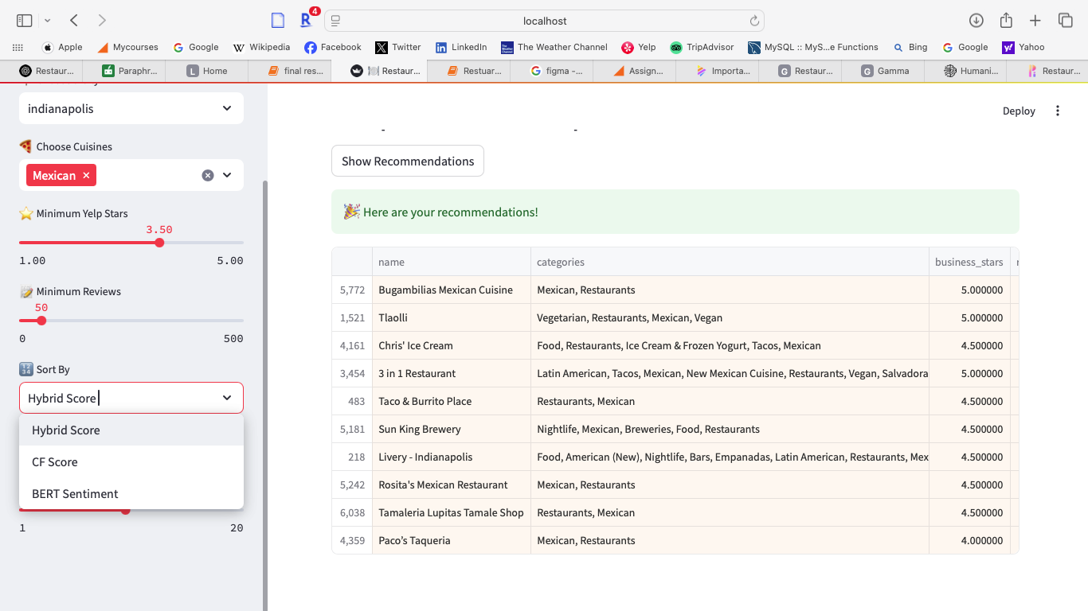
Streamlit App Screenshot
App Sidebar (Filters)
Recommendation Table (Main Area)
Notes:
Here you can see an actual example of the deployed web application running locally. On the left-hand side, the user can see a clean sidebar with multiple filters:
City Selection: Here, the user has selected 'Indianapolis'.
Cuisine Selection: The user has filtered specifically for 'Mexican' cuisine.
Minimum Yelp Stars: The slider is set to 3.5 stars minimum, meaning only well-rated restaurants will appear.
Minimum Reviews: Set at 50 reviews minimum to ensure that only popular, well-reviewed places are recommended.
Sort By: The user has chosen to sort results by the 'Hybrid Score', blending collaborative filtering and sentiment analysis.
After clicking 'Show Recommendations,' the system instantly fetches the best-matching restaurants.
On the right-hand side, we can see the Recommendations Table:
It displays the restaurant name, categories, and business stars.
For example, 'Bugambilias Mexican Cuisine' and 'Tlaolli' both have perfect 5-star ratings and are ranked highest.
Restaurants like 'Chris' Ice Cream' and '3 in 1 Restaurant' also appear, reflecting both popularity and high emotional satisfaction in reviews.
Notice that these recommendations aren’t simply sorted by Yelp stars — they are ranked by a combination of factors, including real customer emotional positivity, review volume, and hybrid score calculations.
Thus, this interface empowers users to discover not only the 'popular' restaurants but also emotionally satisfying hidden gems — making the experience much more trustworthy and personalized."_

Slide 22
Experiment Summary Table
Task | Model/Approach | Metric | Result | Notes
Sentiment Analysis | VADER | Accuracy | 71.2% | Rule-based baseline
Sentiment Analysis | TF-IDF + Logistic Regression | Accuracy | 81.7% | Classical machine learning
Sentiment Analysis | BERT (Fine-tuned) | Accuracy | 91.5% | Best performing sentiment model
Collaborative Filtering | SVD | RMSE | 0.982 | Matrix factorization approach
Recommendation System | Yelp Stars Only | User satisfaction (qualitative) | Medium | Misses emotional context
Recommendation System | CF Only (SVD) | User satisfaction (qualitative) | High | Focuses on ratings history only
Recommendation System | Hybrid (CF + BERT Sentiment) | User satisfaction (qualitative) | Very High | Best personalized recommendations
Notes:
"This table summarizes the key experiments and results.
For Sentiment Analysis, BERT achieved the highest accuracy at 91.5%, outperforming VADER and TF-IDF approaches.
For Collaborative Filtering, the SVD model achieved a strong RMSE score of 0.982, indicating reliable rating prediction performance.
The final Hybrid Recommendation System, combining CF scores and emotional sentiment, produced the most meaningful and user-trustworthy restaurant suggestions. The hybrid system outperformed traditional models by balancing popularity with emotional satisfaction, offering a unique competitive advantage."_

Slide 23
Conclusions
Combining rating history + emotions improves recommendations.
Hybrid system outperforms standalone models.
Deploying app demonstrates practical usability.
Notes:
To conclude, this project successfully demonstrated the value of combining traditional rating-based models with emotional sentiment analysis. The hybrid approach solved multiple key problems:
It improved the personalization of recommendations.
It highlighted authentic, emotionally satisfying dining experiences over simple popularity.
It allowed for dynamic, flexible filtering through the deployed web application. Overall, the project highlights that understanding real user emotions hidden in text reviews can significantly enhance the quality of any recommendation system, not just in restaurants but potentially across multiple domains like travel, hotels, or entertainment."_

Slide 24
Future Work – System Enhancements
Expand dataset to nationwide/global cities.
Integrate real-time review updates.
Add images/menu analysis into recommendations.
Notes:
Looking forward, there are several exciting possibilities for improving and expanding this system.
One idea is to scale the system across more cities, even internationally, to test its robustness on different cuisines and cultures.
Another enhancement would be integrating real-time review analysis — so the system can dynamically adjust hybrid scores based on latest customer feedback.
An advanced future direction is to analyze images — food photos, interior pictures — posted by customers, using computer vision models to extract ambiance and food quality cues. This would make the recommendations even richer and multi-modal.

Slide 25
Future Work – User Personalization
Add user-specific profiles/preferences.
Aspect-based sentiment for food, service, ambiance.
Mobile app version for wider accessibility.
Notes:
"Another important future expansion is deeper user personalization. Currently, the app provides general top recommendations based on filters. In future versions, we could:
Build user-specific profiles, remembering a user's past favorites, preferred cuisines, or visited restaurants.
Apply aspect-based sentiment analysis — separately analyzing reviews for aspects like food, service, and ambiance — allowing users to prioritize what matters most to them.
Finally, a mobile app version could be developed to allow on-the-go restaurant discovery, with location-based alerts for top nearby emotional matches. These extensions would truly complete the vision of emotionally intelligent, personalized restaurant recommendation systems."_

Slide 26
Thank You!

